Slide 1
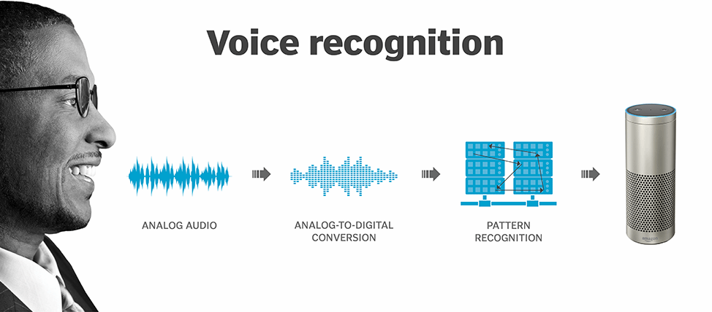
待更新
更新论文信息
文章 | Who is Real Bob? Adversarial Attacks on Speaker Recognition Systems
arxiv | https://arxiv.org/abs/1911.01840
发表于
总结在前：这篇文章生成对抗样本的方法比较独特，随机选择perturbation后择优更新样本。实现了黑盒、物理/API、targeted/untargeted的对声纹识别的攻击，主要这对ivector、GMM模型，效果非常不错，实验设计得非常完整。不过我认为现在的声纹识别一个是效果并没有那么理想，另一个是实际的使用场景还没有那么广泛，即使是语音助手中的声纹识别仍然是较弱的声纹识别方法。对于某些攻击和实验设计上，我跟作者的想法有一些不同，一些细节的点我没有Get到。

Slide 2
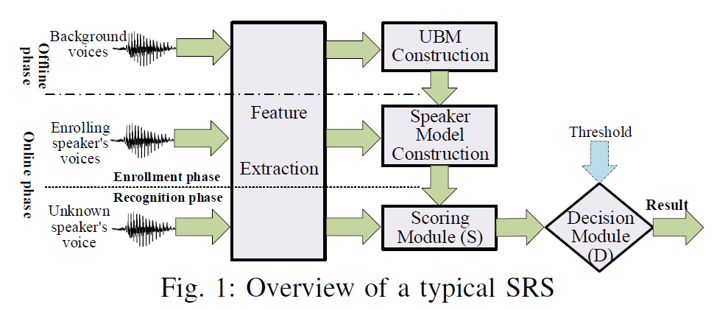
Overview of SRSs (Speaker Recognition Systems)
Speaker Recognition Tasks.
Open-set Identification (OSI) -> 识别为哪一个说话人或reject
Close-set Identification (CSI) -> 识别为哪一个说话人
Speaker Verification (SV) -> 验证是否是目标说话人
Text Dependency.
Text-dependent
Text-independent
SRS Implementation.
ivector-PLDA
GMM-UBM
xvector-PLDA
Overview of SRSs (Speaker Recognition Systems)
Black-box setting, has access only to the recognition result (decision result and scores)
Attack on Open-source Platform (Kaldi) and Commercial platform (Talentedsoft, Microsoft Azure for transferable attack), so it’s not so great.
Both targeted and untargeted attacks.

Slide 3
Motivation and Design Philosophy
Q1: How to launch an adversarial attack against all the tasks of SRSs in the practical black-box setting?
R1: Using the NES(Natural Evolution Strategy)-based gradient estimation.
Q2: Is it feasible to craft robust adversarial voices that are transferable to an unknown SRS under cross-architecture, cross-dataset and cross-parameter circumstances, and commercial systems, even when played over the air in the physical world?
R2: we increase the strength of adversarial samples and the range of noise amplitude, instead of using noise model.
U2: 作者只是说明了”played over the air”这一点，但是并没有解释”cross-architecture, cross-dataset and cross-parameter circumstances and commercial systems”这个如何解决. 作者在后面的实验中有对这一块做具体的实验，这边的解释不是非常详细。

Slide 4
Motivation and Design Philosophy
Q3: Is it possible to craft human-imperceptible adversarial voices that are difficult, or even impossible, to be noticed by ordinary users?
R3: The adversarial samples should sound natural when listened by ordinary users. Second, and more importantly, they should sound as uttered by the same speaker of the original one. we add a constraint onto the perturbations using L1 norm, which restricts the maximal distortion at each sample point of the audio signal.
U3: 我觉得作者这样的思路是错误的。我们考虑重放攻击的场景，如果攻击者可以获取到受害者的目标语音（如文本相关的验证口令），那么攻击者根本就不必要生成对抗样本了，重放就可以了。那么攻击者在生成对抗样本攻击目标SRS的过程中，根本就不必考虑对抗样本的音色是否和原用户的保持一致，即使是和目标用户的相似也是可以接受的.
Q4: If such an attack exists, can it be defended?
R4: audio squeezing, local smoothing, quantization and temporal dependency detection.

Slide 5
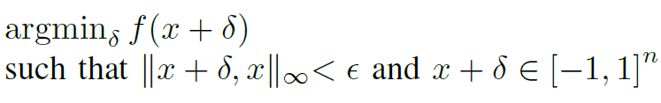


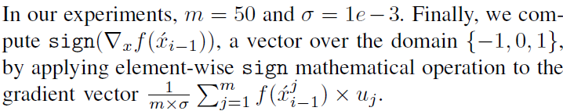
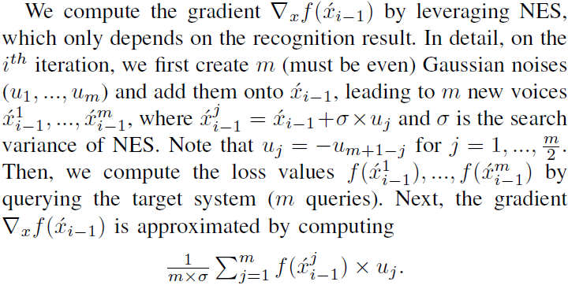
The Attack on OSI
Problem Formulation:
Loss Function:
Targeted Attack:
Untargeted Attack:
Solving the optimization problem:
就很困惑这边是怎么设计的，当对抗样本满足loss function的要求时，f(x)为负数，那么在optimization的过程中让perturbation乘以一个负值，意思是不好么？这显然是好的呀？我认为他的loss function设计有问题：

Slide 6
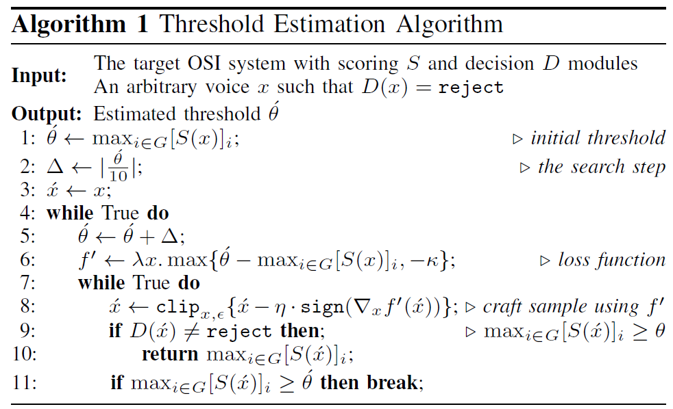
The Attack on OSI
Estimating the threshold θ:
作者整个的思想，和传统的通过梯度迭代的方法不同，他是通过随机生成perturbation，然后选择好的perturbation进行迭代生成对抗样本，这个过程中，作者不需要任何替代模型，但比较依赖目标SRS的输出概率S(x).
这种方法更加接近于遗传算法的思想，但是我比较怀疑的一个点是：你分别往两个方向添加perturbation的结果是好的(概率增加)，但是你同时往两个方向都添加一定是好的吗？这个比较依赖于Machine Learning的决策边界吧？

Slide 7
Attack Evaluation - Overview
Evaluate the influence of the parameter ε.
Evaluate the OSI/CSI/SV attack on open-source platform Kaldi.
Evaluate the Threshold Estimation method.
Evaluate the attack on the commercial system Talentedsoft.
Evaluate the transferability of attack.
Evaluate the influence of the parameter κ.
Evaluate the attack on the commercial system Microsoft Azure (using transferability).
Evaluate the Over-the-Air attack.
Human study. (结果没有罗列)
Robustness of FAKEBOB against Defense Methods. (结果没有罗列)

Slide 8
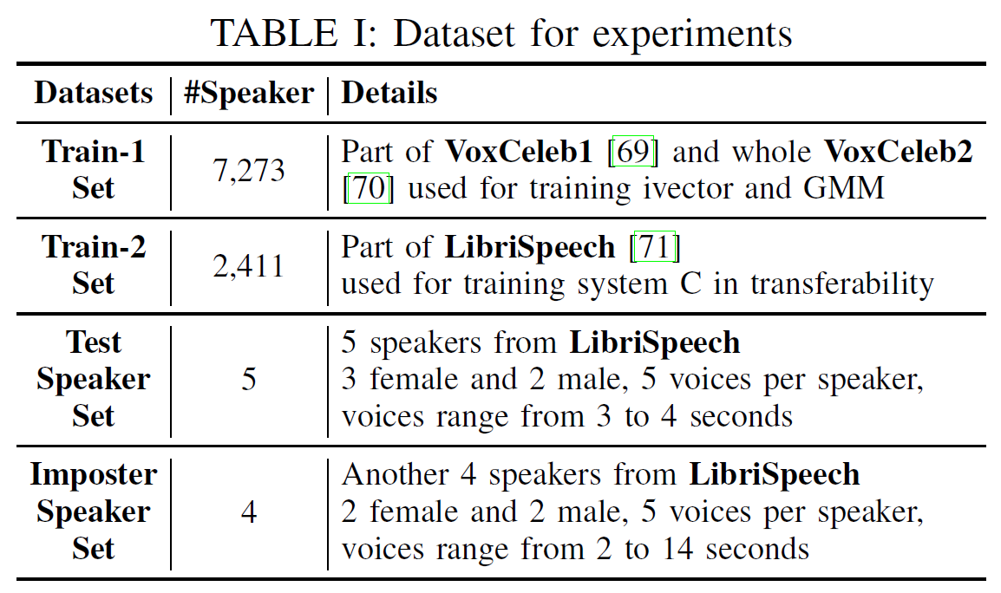
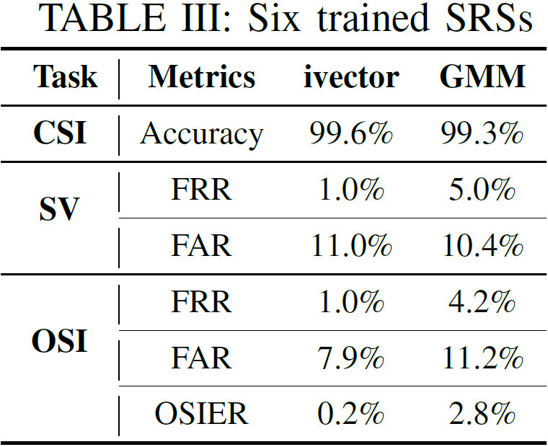
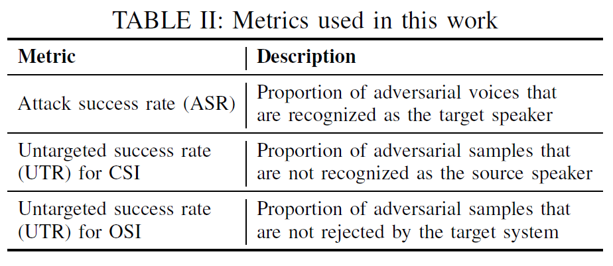

Attack Evaluation
Dataset:
Evaluation Metrics:
Training Model Setting and Result:
Testing Setting:
Set θ 1.45 and 0.091 for ivector and GMM
Set ε=0.002 and m=50
K 是多少？没有交代

Slide 9
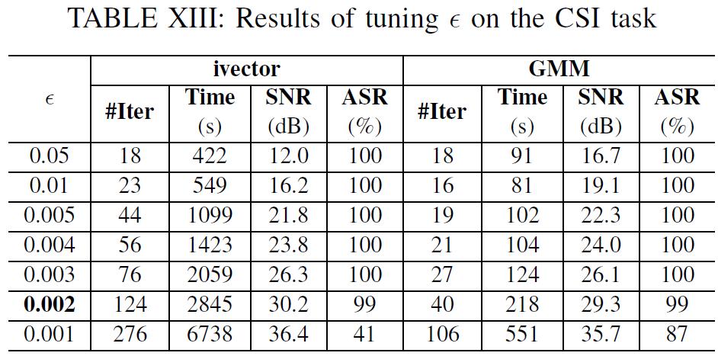
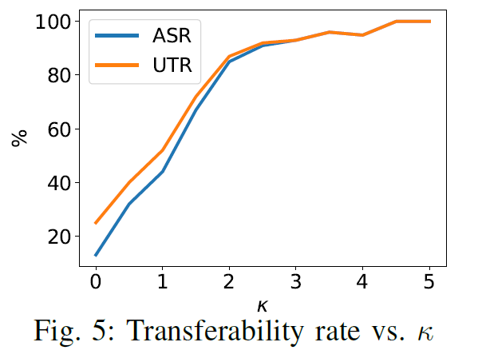
Attack Evaluation
Evaluate the influence of parameter ε:
Evaluate the influence of parameter κ:
ε越小，程序可以添加的perturbation越少，使得成功率下降，需要的迭代轮数增加，实验中挑选值0.02；

Slide 10
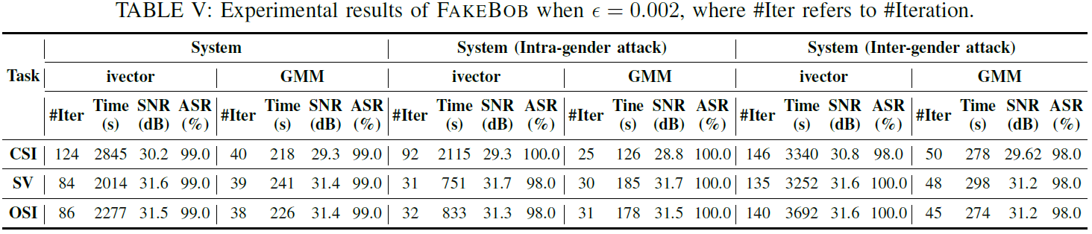
Attack Evaluation
Result of Attack Success Rate on open-source platform Kaldi:
优点：
成功率都不错，超过了95%，甚至达到了100%；
SNR都特别大，说明添加的perturbation都比较小；
思考：
为什么GMM的迭代次数明显低于ivector呢？
缺点：
这种方法访问API的次数都特别多，根据m=50来说，实现一次攻击最少也要1500次的API访问，这是不太现实的；

Slide 11
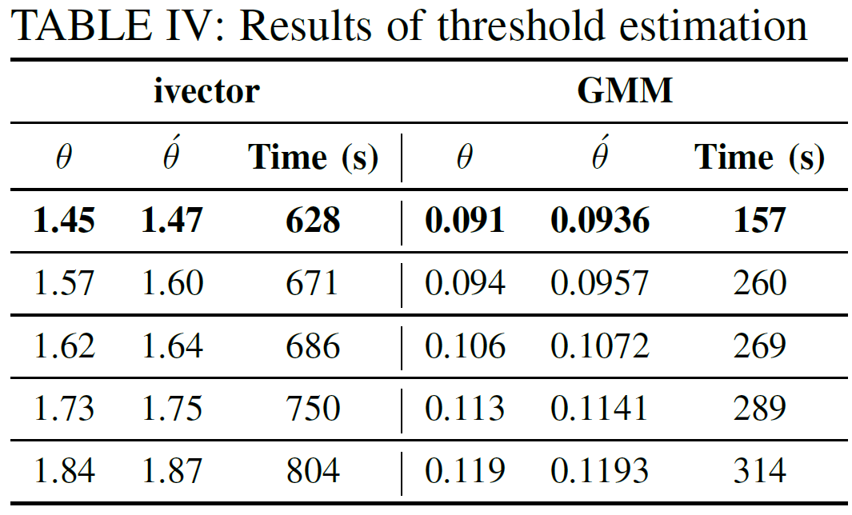

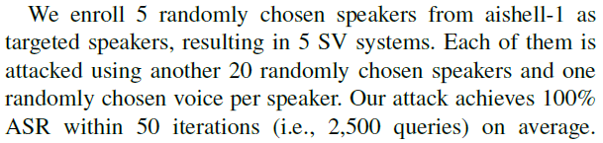
Attack Evaluation
Result of Threshold Estimation:
Attacking the commercial system Talentedsoft:
效果都还不错，阈值的估计误差较小，并且在黑盒系统上有比较好的效果.

Slide 12
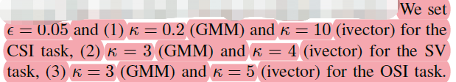
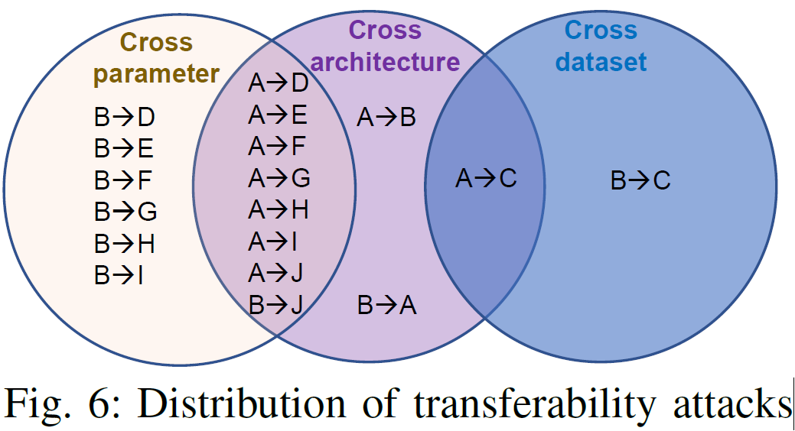
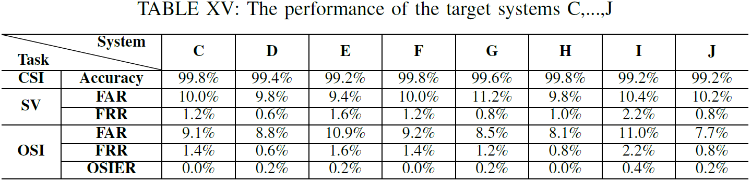
Attack Evaluation
Evaluate the Transferability
Settings: 也没说明训练用的阈值啊？
Distribution of transferability attacks:
Trained Model Performance:

Slide 13
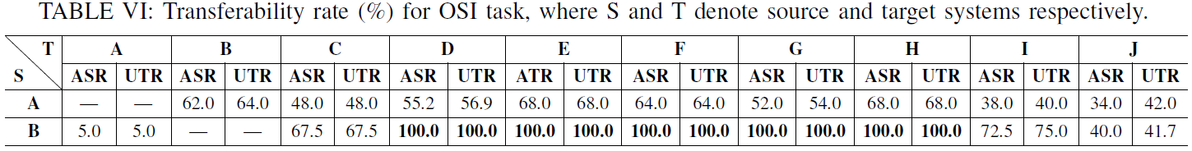
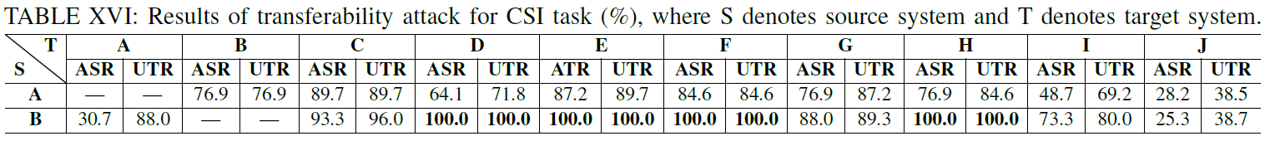
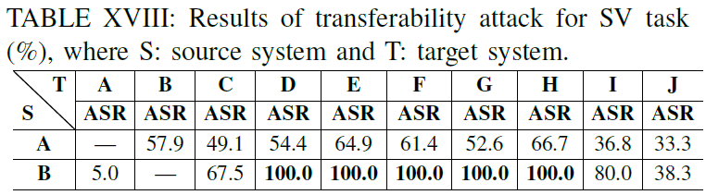
Attack Evaluation
Evaluate the Transferability
Attacking Result:
有趣但是符合预期的几个发现：
Cross architecture reduces transferability rate.
Cross dataset reduces transferability rate.
Transferring from the architecture ivector (B) to GMM (A) is more difficult.
The larger the difference between the source and target systems is, the more difficult the transferability attack is.

Slide 14
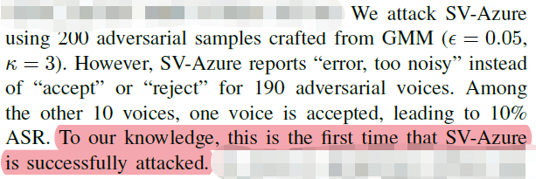
Attack Evaluation
Evaluate the influence of parameter κ:
Attacking the commercial system Microsoft Azure
Azure会检测噪声的大小；
跨平台的能力也好，可能是因为不平模型结构的差异导致；
对于噪声这一点，可以这样理解，我们在做对抗样本的时候，不必一味地追求在噪声环境下是鲁棒的，而应该追求在噪声环境下和原始音频的效果是相同的，而人耳上面的效果则是nature即可。
κ 越大，表示对抗样本在source target system上面的成功率越高，修改得也越多，在跨平台的能力上显得更好.
这里没有使用DNN模型，ivector和GMM模型都是统计模型，可能模型差异不是很大，所以在跨平台能力上比较好。

Slide 15
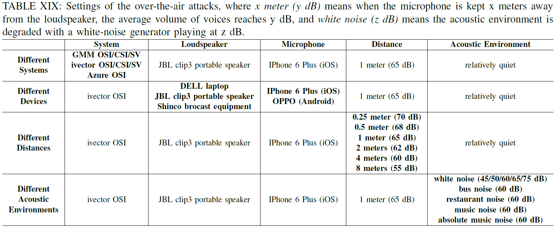
Attack Evaluation
Practicability for Over-the-Air Attack
Over-the-Air Settings:
作者测试了不同的系统、扬声器、麦克风、距离和背景噪声的影响

Slide 16
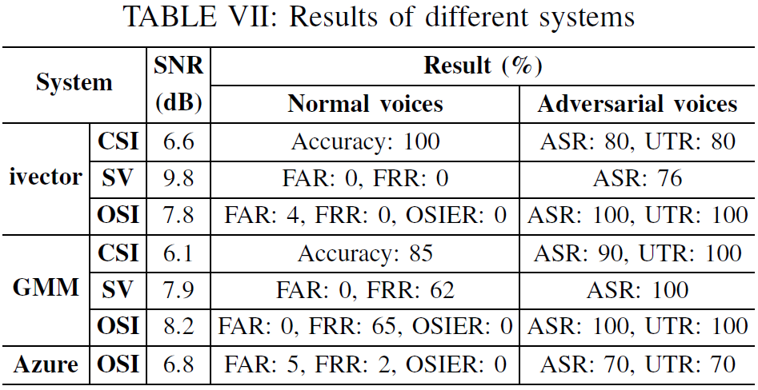
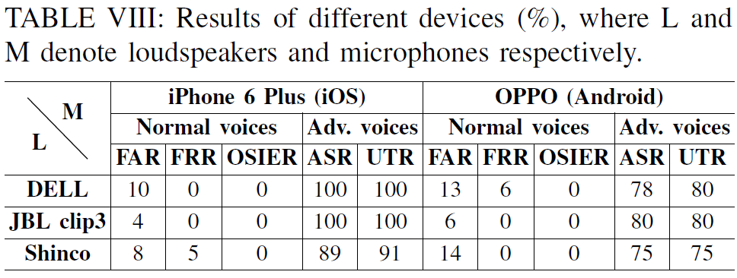
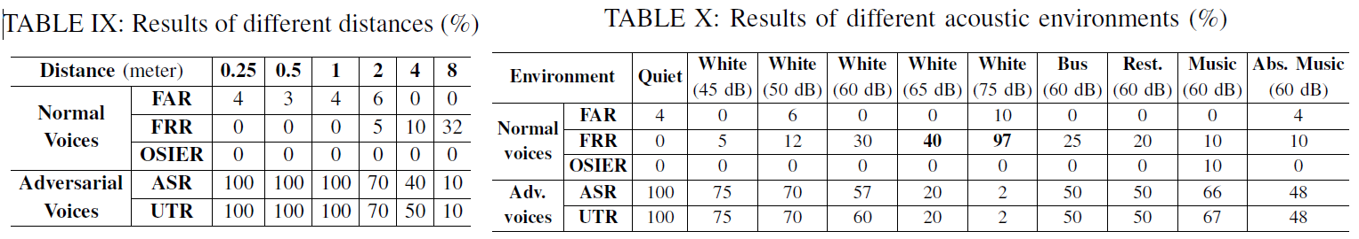
Attack Evaluation
Practicability for Over-the-Air Attack
如何实现这么好的物理攻击场景的？是因为大的k么？
Result of different systems:
Result of different device:
Result of different distances:
Result of different acoustic environments:

Slide 17
Discussion
个人觉得这是一篇非常不错的文章，实验做的很详细，在生成对抗样本方面提出了一种新的方法。
在语音的对抗样本领域，还是没有人提出“重要的特征”这个点；
说话人识别这边正在研究“活体检测”，并且“动态文本”认证也是一个可以很大地限制对抗样本的方法，这也是这篇文章不太好实现实际攻击的点；
接上第一点，可能是因为没有重要特征的指导，可以看到语音对抗样本在物理攻击的时候SNR都比较小，需要添加的噪声都比较多，这和整个信道的好坏是相关的；我觉得SNR可能以后不是一个很好的评价指标。我们理解对抗样本的声学特征的好坏，应该用“可否感知”和“是否异常”来度量，但是这个是很难提出一个好的度量指标的；
作者的攻击非常得依赖模型输出一个score，我们是否可以通过后门攻击、偷模型和对抗样本生成三种方法的结合，来迭代优化对抗样本的生成，这样就能做到原始模型逼近，对抗样本有针对性；
More to Read
Attack on Speaker Recognition:
Y. Gong and C. Poellabauer, “Crafting adversarial examples for speech paralinguistics applications,” in DYNAMICS, 2018.
F. Kreuk, Y. Adi, M. Cisse, and J. Keshet, “Fooling end-to-end speaker verification with adversarial examples,” in ICASSP, 2018.
Poisoning Attack on Speech System:
H. Abdullah, M. S. Rahman, W. Garcia, L. Blue, K. Warren, A. S. Yadav, T. Shrimpton, and P. Traynor, “Hear ”no evil”, see ”kenansville”: Efficient and transferable black-box attacks on speech recognition and voice identification systems,” CoRR, vol. abs/1910.05262, 2019.
Attack on Speech Recognition:
M. Alzantot, B. Balaji, and M. B. Srivastava, “Did you hear that? adversarial examples against automatic speech recognition,” CoRR, vol. abs/1801.00554, 2018.

